Slide 1

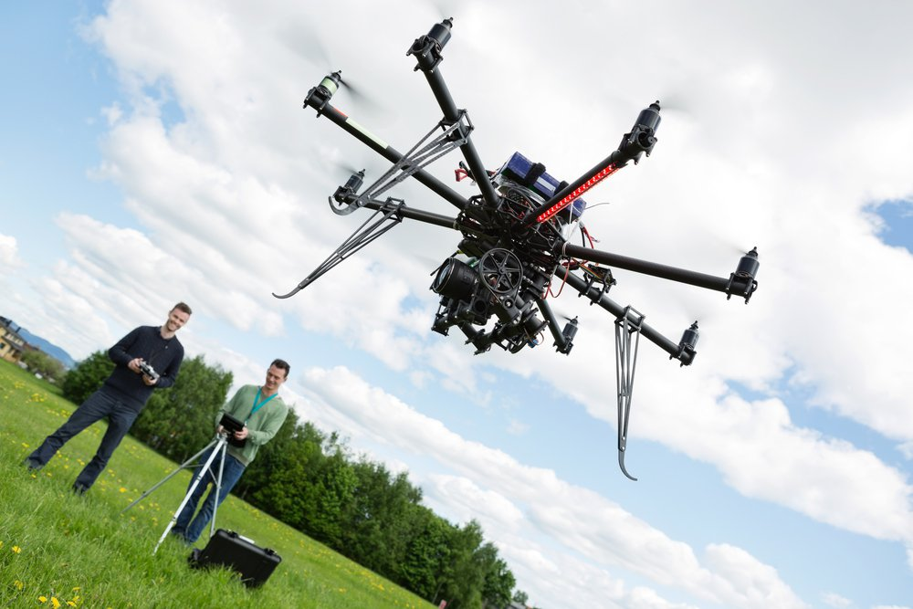
ENGINEERING DESIGN
USAGE OF DRONES IN FORESTRY
This Photo by Unknown Author is licensed under CC BY

Slide 2
TEAM MEMBERS
1.ADITYA UPADHYA
2.MOHANKUMAR K
3.NITIN C KALLAPPA
4.PAVANKUMAR K R
5.PRATEEK KUMAR

Slide 3
CONTENTS
INTRODUCTION
SALIENT FEATURES OF DRONES
TECHNICAL FACTORS
NON-TECHNICAL FACTORS
DEVELOPMENT OF DRONE
MULTIPLE USES
CONCLUSION
REFERENCES

Slide 4
INTRODUCTION
Various solutions for the problem.
Reasons for selecting the particular solution, i.e drones.
Favorable features of the drones.
Brief explanation about salient features of the drones.

Slide 5
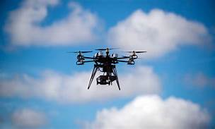
FEATURES OF DRONES
Equipment
Cameras
GPS
Navigation Systems
Sensors

Slide 6
TECHNICAL FACTORS
FLIGHT ENDURANCE
PAYLOAD CAPACITY
FAVORABLE TEMPERATURE CONDITIONS
ENERGY CONSERVTION

Slide 7
NON-TECHNICAL ASPECTS
SOCIAL ASPECTS
SOCIAL ACCEPTENCE
RELIABILITY
SAFETY
ECONOMIC ASPECTS
ENVIRONMENTAL FACTORS

Slide 8
NON-TECHNICAL FACTORS
JUDICIAL ASPECTS
LAWS
LICENSE
JUDGEMENTS
CULTURAL AND MORAL ISSUES

Slide 9
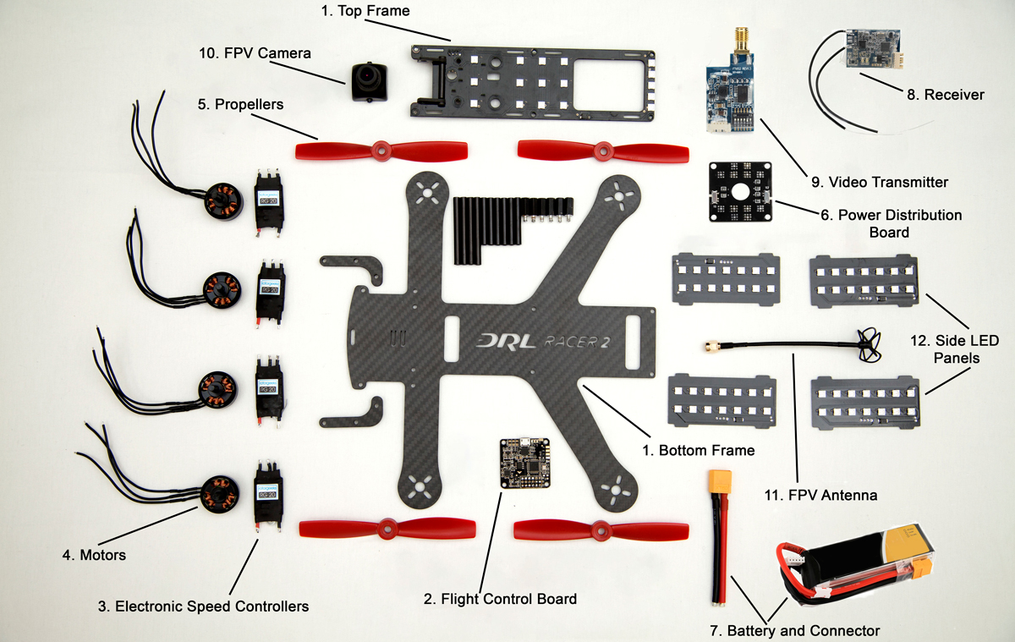
CONSTRUCTION OF DRONES

Slide 10
MULTIPLE USES OF DRONES
FOREST MAPPING AND BIODIVERSITY
FOREST MANAGEMENT
CAPTURING FOREST DATA
3D MAPPING FOR CARBON STORAGE
MANAGING CANOPY GAPS AND MEASURING
FOREST RESEARCHING
PRECISION FORESTRY

Slide 11
MULTIPLE USES OF DRONES
RESTORATION OF SCORCHED LANDS
SAVING RAINFORESTS
MONITORING ILLEGAL ACTIVITIES
MEASURING FOREST STOCKPILES
COMBATING DEFORESTATION
FOREST SECURITY

Slide 12
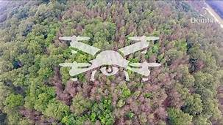
SUMMARY AND CONCLUSION

Slide 13
REFERENCES
https://www.edie.net/news/8/Drone-technology-environmental-sustainability-impact-for-the-UK/
https://www.sustainablebusinesstoolkit.com/sustainability-of-drones/
https://www.researchgate.net/publication/298427201_The_societal_impact_of_commercial_drones
https://www.google.com/amp/s/www.forbes.com/sites/stephenrice1/2019/02/04/eyes-in-the-sky-the-public-has-privacy-concerns-about-drones/amp/
https://www.google.com/url?sa=t&source=web&rct=j&url=https://digitalempowers.com/drones-revolutionising-way-forests-managed/&ved=2ahUKEwj_rZCX4aDiAhUr4nMBHW_8CYYQFjAZegQICBAB&usg=AOvVaw2nQtloEdAsPgrFx5596Irj

